Slide 1
REPUTATION DE L’INFORMATION
Big Data

Slide 2
Big Data
Etudes des besoins
Mise en place
Visualisation des résultats

Slide 3
Etudes des besoins
Description des objectifs d’analyse de données
Etude de cas
Identifcation des sources de données adéquates

Slide 4
Mise en place
Préparation d’un environement de stockage et traitement de données
Construction d’un data lake
Traitement de données
Analyse de données

Slide 5
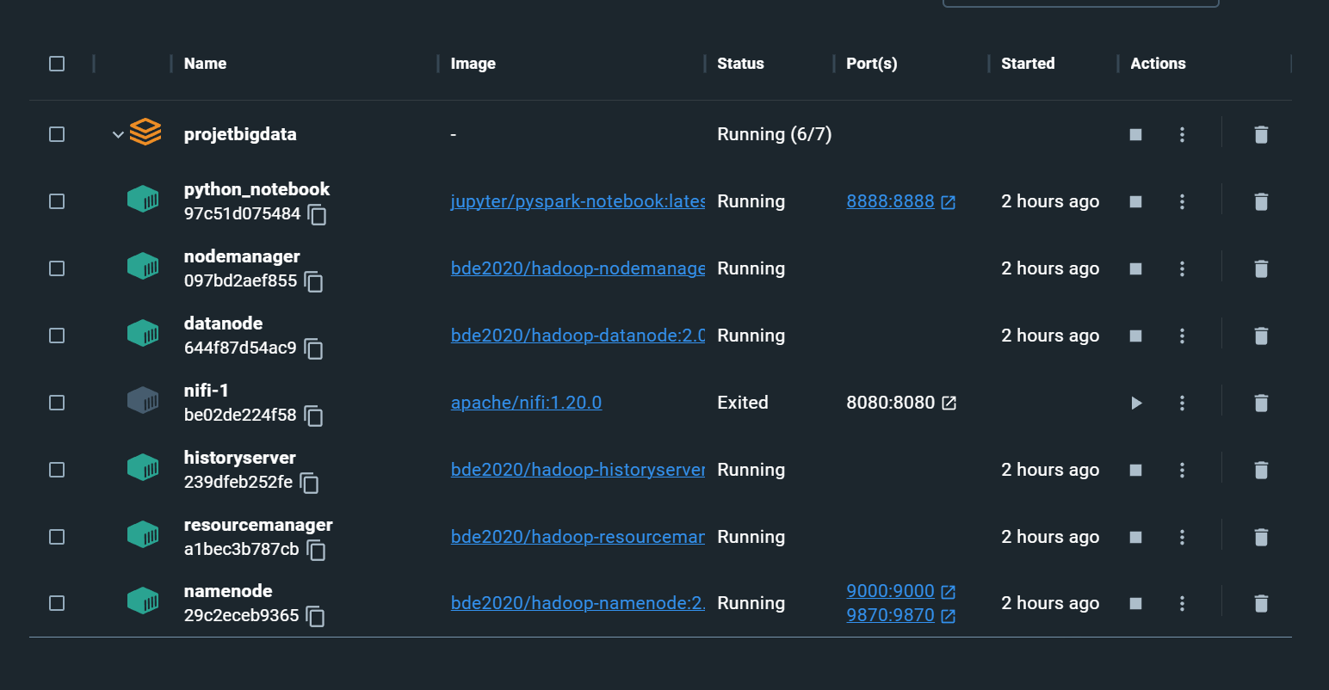
Préparation d’un environnement de stockage et traitement de données
Creation des images
Et des conteneurs

Slide 6
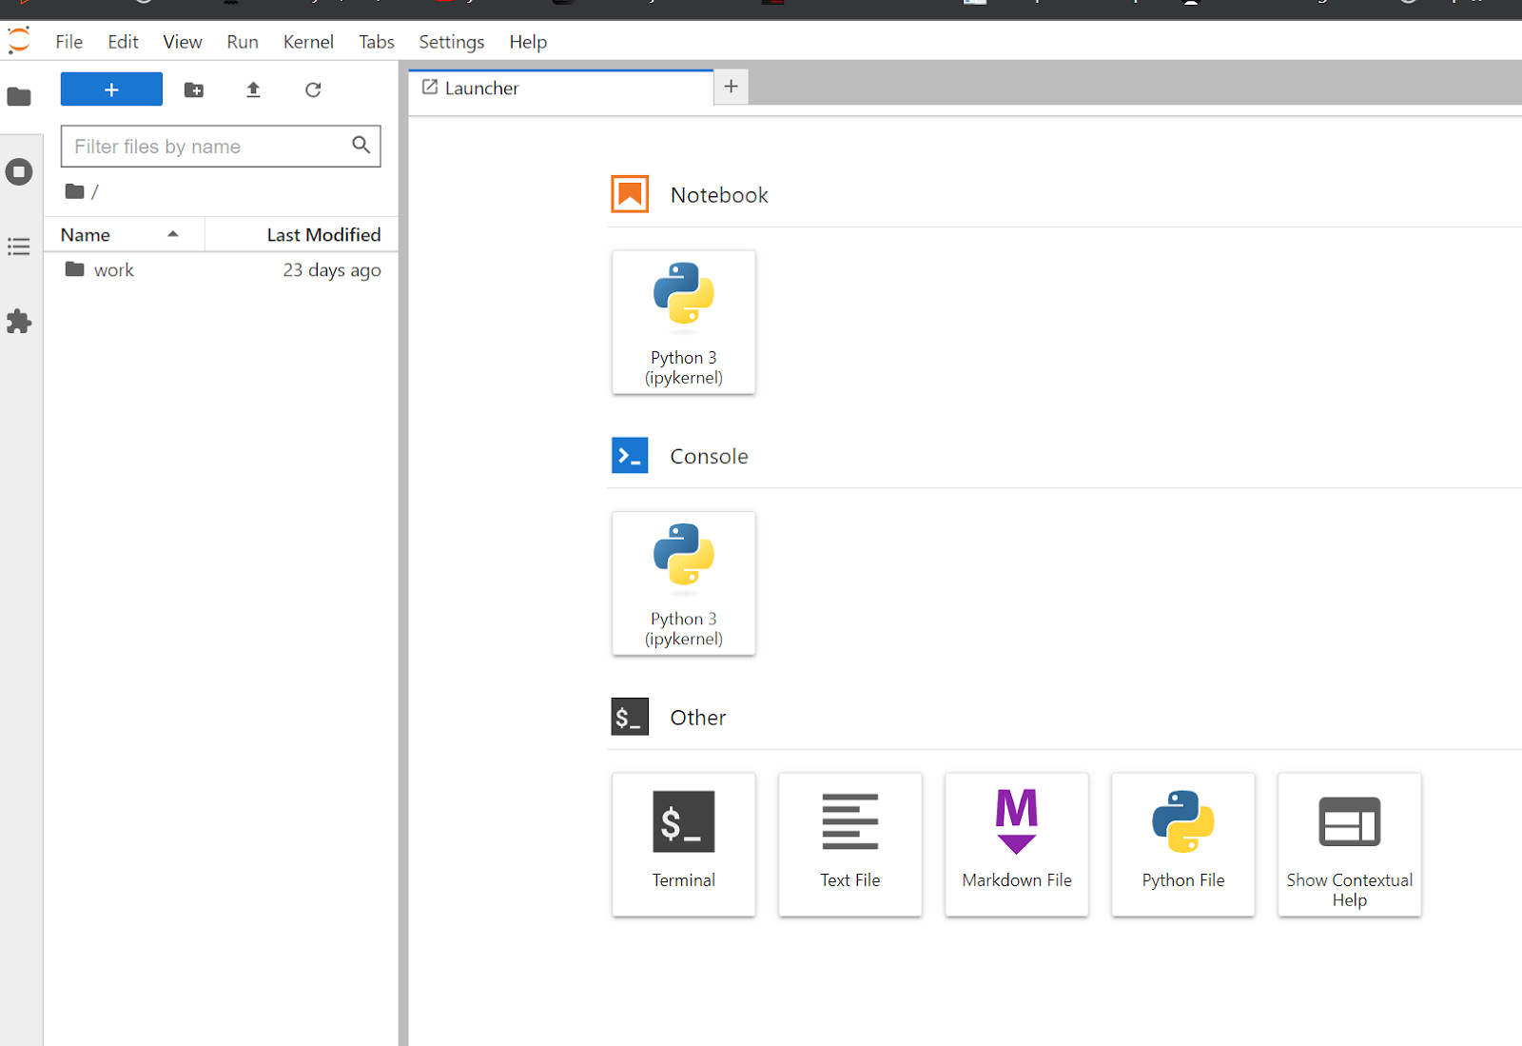
Préparation d’un environnement de stockage et traitement de données
JUPITER

Slide 7
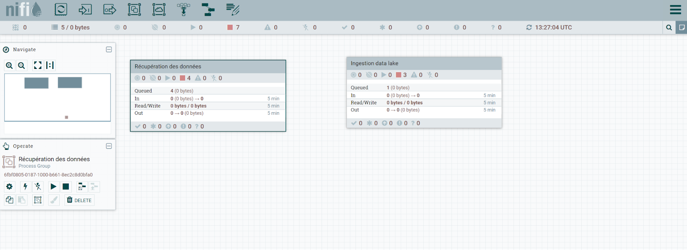
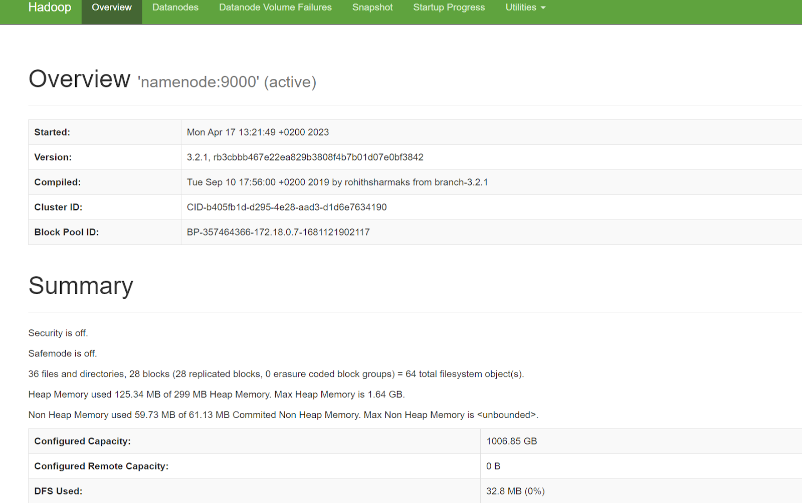
Préparation d’un environnement de stockage et traitement de données
NIFI
Hadoop HDFS

Slide 8
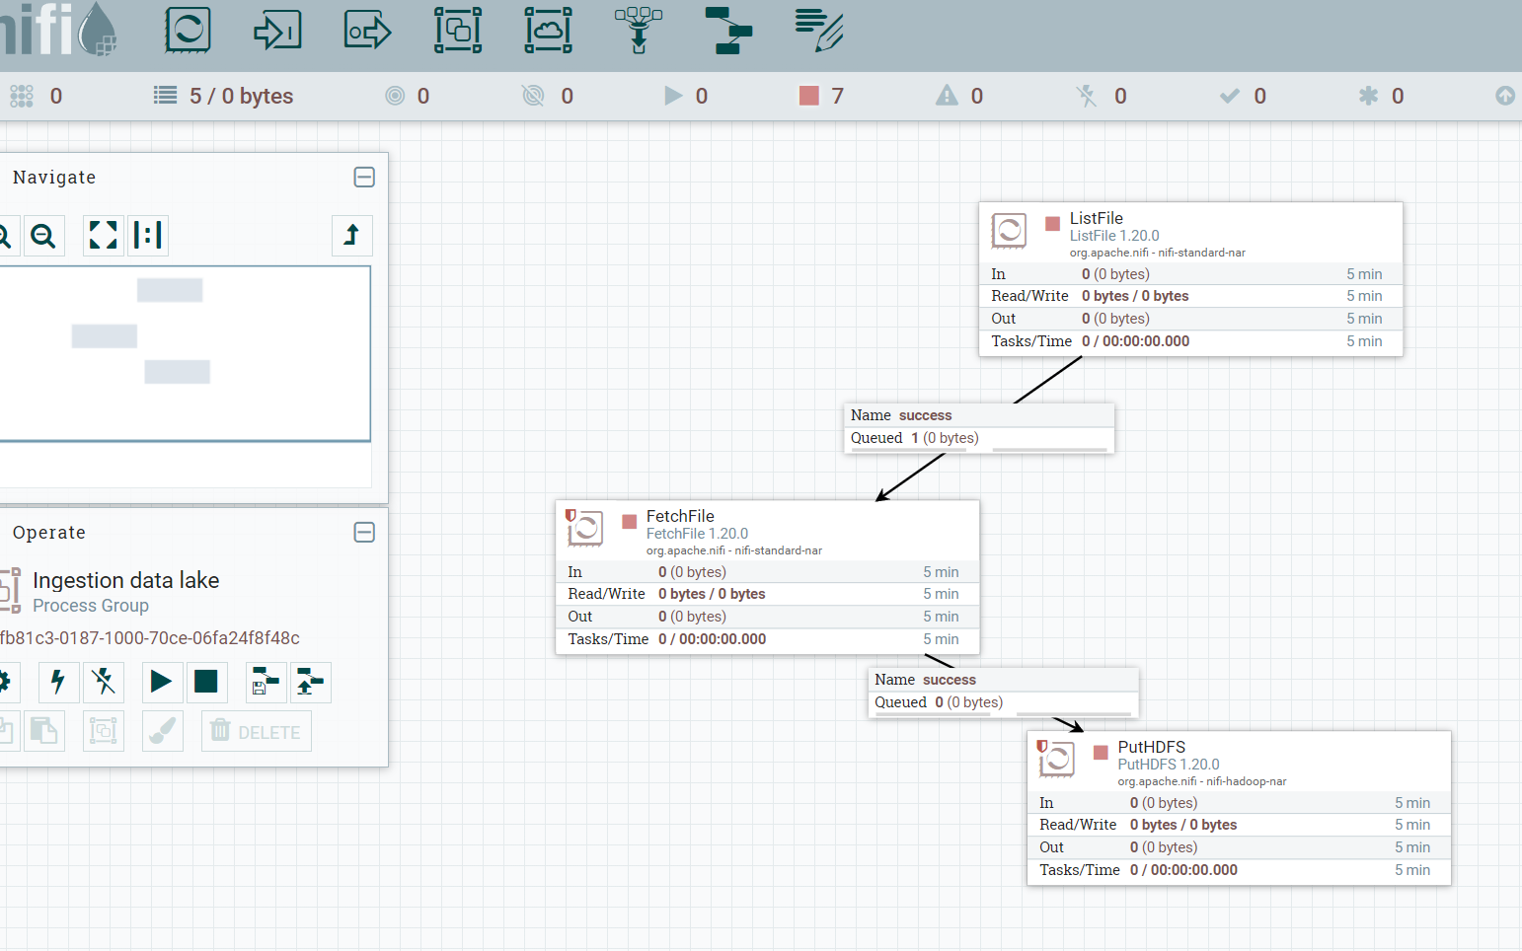
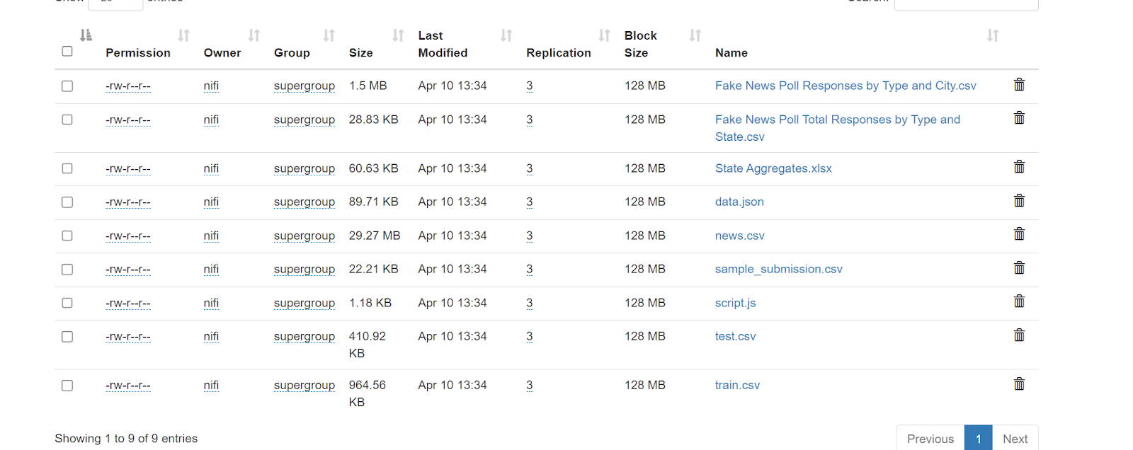
Construction du Data lake
Récupération des données
Observations dans hdfs après injection

Slide 9
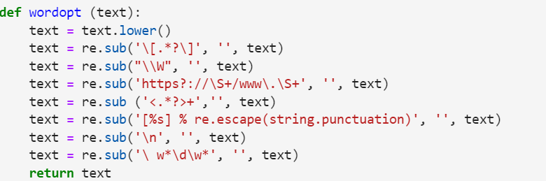
Construction du Data lake

Slide 10
Analyse des données
-Scikit-learn
-TfidfVectorizer
A
91,55%
Regression logistique
B
C
91,55%
Arbre de décision
D
81,22%
Gradient boosting machine
90,21%
Arbres decisionnels

Slide 11
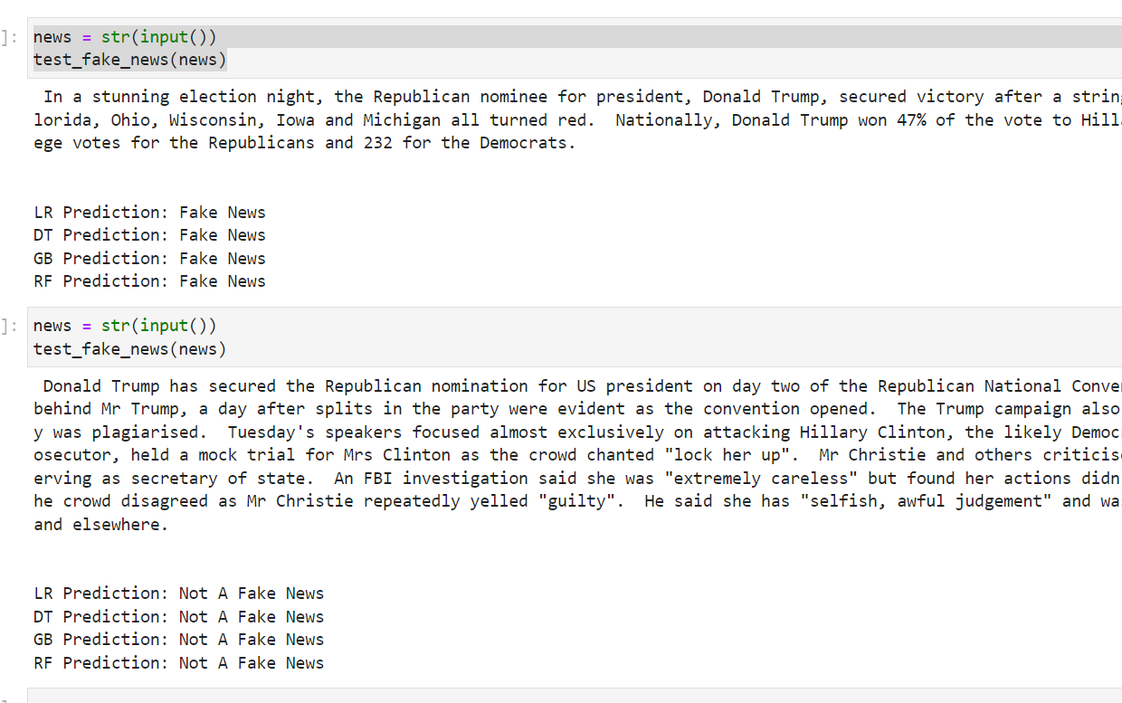
Visualisation des Resultats

Slide 12
Big Data Infographics
Mercury
Earth
Mercury is the closest planet to the Sun
It’s the planet where we all live on
Mars
Venus
Despite being red, Mars is a cold place
Venus is the second planet from the Sun
Jupiter
Saturn
It’s a gas giant and the biggest planet
Saturn is the ringed one. It’s a gas giant

Slide 13
Big Data Infographics
75%
Mars
Mars is actually actually a cold place. It’s full of iron oxide dust
50%
Mercury
60%
Mercury is the closest planet to the Sun and the smallest one
Saturn
Saturn is composed of hydrogen and helium and is the ringed one

Slide 14
Big Data Infographics
Data
Decision
Despite being red, Mars is a cold place full of iron oxide dust
01
02
Venus has a beautiful name, but also very high temperatures
Info
Insight
Mercury is the closest planet to the Sun and the smallest one
04
03
Jupiter is a gas giant and the biggest planet in the Solar System

Slide 15
Big Data Infographics
Data
Decision
01
Despite being red, Mars is a cold place. It’s full of iron oxide dust
Mars is full of iron oxide dust, which gives the planet its reddish cast
02
04
Insight
Info
03
Mercury is the closest planet to the Sun and the smallest one of them all
Jupiter is a gas giant and the biggest planet in the Solar System

Slide 16
Big Data Infographics
70%
35%
80%
50%
Mercury
Mars
Jupiter
Saturn
Mercury is the closest planet to the Sun and the smallest one
Despite being red, is actually cold and full of iron oxide dust
It’s a gas giant and the biggest planet in the Solar System
Saturn is composed mostly of hydrogen and also helium

Slide 17
Big Data Infographics
Mercury
Mercury is the closest planet to the Sun
Mars
Despite being red, Mars is a cold place
Saturn
It’s composed of hydrogen and helium
Neptune
It’s the farthest planet from the Sun
55%
74%
67%
89%

Slide 18
Big Data Infographics
Data Risk
Interpretation Risk
Data Security
Data Quality
Model Risk
Interpretation Risk
Mercury is the closest planet to the Sun and the smallest
Despite being red, Mars is cold and full of iron oxide dust
It’s a gas giant and the biggest planet in the Solar System
Saturn is composed mostly of hydrogen and helium

Slide 19
Big Data Infographics
20%
Venus has a beautiful name and is the second one from the Sun
40%
Mercury is the closest planet to the Sun and the smallest one
60%
Despite being red, Mars is a cold place full of iron oxide dust
Venus
Mercury
80%
Mars
Jupiter
It’s a gas giant and the biggest planet in the Solar System

Slide 20
Big Data Infographics
Mercury
Saturn
Mercury is the closest planet to the Sun
It’s composed of hydrogen and helium
Mars
Neptune
Despite being red, Mars is a cold place
Neptune is the farthest planet from the Sun
20%
60%
40%
80%

Slide 21
Big Data Infographics
Data
Decision
Saturn is a gas giant and has several rings
23%
60%
75%
100%
Mars is full of iron oxide dust and has a reddish cast
Neptune
23%
Venus
60%
Insight
Info
Mercury is the smallest planet in the Solar System
Mars
75%
Jupiter is a gas giant and the biggest planet
Saturn
100%

Slide 22
Big Data Infographics
Venus is the second planet from the Sun
Cost
Despite being red, Mars is a cold planet
Backup
Mercury is the closest planet to the Sun
Safety
Big Data Challenges
Jupiter is the biggest planet of them all
Data Structure
Data Management
Saturn is a gas giant and has several rings
Transformation
Venus has a really beautiful name

Slide 23
Big Data Infographics
Data Security
Despite being red, Mars is actually a cold place
60%
Data Quality
Mercury is the closest planet to the Sun
45%
Model Risk
Jupiter is a gas giant and the biggest planet
70%
Interpretation Risk
Yes, Saturn is the ringed one. It’s a gas giant
50%

Slide 24
Big Data Infographics
Data
Insight
Despite being red, Mars is actually a very cold place
Venus has a beautiful name and is the second planet
45%
90%
65%
70%
25%
40%

Slide 25
Big Data Infographics
Data interpretation
Structured data
Mars is actually a cold place
Jupiter is the biggest planet
Geo expansion
Variability
Mercury is a small planet
Neptune is far away from Earth
50%
40%
30%
20%

Slide 26
Big Data Infographics
Volume
Venus has a beautiful name and is the second one from the Sun
40%
30%
Variety
Mercury is the closest planet to the Sun and the smallest one
Veracity
Despite being red, Mars is a cold place full of iron oxide dust
60%
50%
Value
Jupiter is a gas giant and the biggest planet of them all

Slide 27
Big Data Infographics
Insight 1
Mercury
Planet Mercury is the smallest one in the entire Solar System
Mars
Despite being red, Mars is actually a cold place full of iron oxide dust
90%
70%
40%
Jupiter
Mercury
Mars
Jupiter
90%
70%
40%
Planet Jupiter is a gas giant and the biggest one in the Solar System
Insight 2

Slide 28
Big Data Infographics
01
Volume
Jupiter is the biggest planet of them all
04
Veracity
02
Earth is the planet where we live on
Velocity
5 Vs of Big Data
Venus is the second planet from the Sun
05
Value
03
Mercury is the closest planet to the Sun
Variety
Despite being red, Mars is a cold place

Slide 29
Big Data Infographics
Mars
Despite its reddish cast, it’s actually an incredibly cold place
50%
70%
80%
Mercury
Mercury is the closest planet to the Sun and the smallest one of them all
700$
400$
800$
500$
2017
Saturn
2018
Saturn is a planet composed mostly of hydrogen and helium, and has rings
2019
2020

Slide 30
Big Data Infographics
Low Volume
High Volume
Mercury is the closest planet to the Sun
Jupiter is the biggest of them all
Batch
Small Data vs. Big Data
Real-Time
Despite being red, Mars is a cold place
Venus is the second planet from the Sun
Structured
Multi-Structured
Earth is the planet where we live on
Saturn is the ringed one. It’s a gas giant

Slide 31
Big Data Infographics
Volume
50%
Venus has a beautiful name and is the second one from the Sun
Variety
60%
Mercury is the closest planet to the Sun and the smallest one
Veracity
75%
Despite being red, Mars is a cold place full of iron oxide dust
Value
70%
Jupiter is a gas giant and the biggest planet of them all

Slide 32
Big Data Infographics
Despite being red, Mars is actually a cold place
Value
Mercury is the smallest planet in the Solar System
Veracity
Earth is the third planet from the Sun and the one with life
Variety
Neptune is the farthest planet from the Sun and a gas giant
Velocity
Jupiter is a gas giant and the biggest planet of them all
Volume

Slide 33
Big Data Infographics
Data 1
Data 2
01
Mercury is the smallest planet in the Solar System
02
Mars is actually a cold place, it’s full of iron oxide dust
40%
80%
03
Jupiter is a gas giant and the biggest of them all
04
Saturn is composed of hydrogen and helium
60%
30%
70%
55%
55%
35%

Slide 34
Big Data Infographics
01
Mercury is the closest planet to the Sun
Volume
02
Venus is the second planet from the Sun
Velocity
4 Vs of Big Data
03
Jupiter is a gas giant and the biggest planet
Veracity
04
Yes, this is the ringed one. It’s a gas giant
Variety

Slide 35
Big Data Infographics
Venus
Venus has a beautiful name and is the second planet from the Sun
Data 1
70%
35%
70%
35%
Mercury
Mercury is the closest to the Sun and the smallest one
50%
Mars
65%
Despite being red, it’s a cold place. It’s full of iron oxide dust
Data 2
60%
Jupiter
Jupiter is a gas giant and the biggest planet in the Solar System
40%

Slide 36
Big Data Infographics
Mercury
321k
35%
Mercury is the closest planet to the Sun and the smallest one in the Solar System
288k
Neptune
65%
Neptune is the farthest planet from the Sun. It’s the fourth-largest by diameter
Mars
189k
75%
Despite being red, Mars is a cold place. The planet is full of iron oxide dust

Slide 37
Instructions for use (free users)
In order to use this template, you must credit Slidesgo by keeping the Thanks slide.
You are allowed to:
Modify this template.
Use it for both personal and commercial purposes.
You are not allowed to:
Sublicense, sell or rent any of Slidesgo Content (or a modified version of Slidesgo Content).
Distribute this Slidesgo Template (or a modified version of this Slidesgo Template) or include it in a database or in any other product or service that offers downloadable images, icons or presentations that may be subject to distribution or resale.
Use any of the elements that are part of this Slidesgo Template in an isolated and separated way from this Template.
Delete the “Thanks” or “Credits” slide.
Register any of the elements that are part of this template as a trademark or logo, or register it as a work in an intellectual property registry or similar.
For more information about editing slides, please read our FAQs or visit Slidesgo School:
https://slidesgo.com/faqs and https://slidesgo.com/slidesgo-school

Slide 38
Instructions for use (premium users)
In order to use this template, you must be a Premium user on Slidesgo.
You are allowed to:
Modify this template.
Use it for both personal and commercial purposes.
Hide or delete the “Thanks” slide and the mention to Slidesgo in the credits.
Share this template in an editable format with people who are not part of your team.
You are not allowed to:
Sublicense, sell or rent this Slidesgo Template (or a modified version of this Slidesgo Template).
Distribute this Slidesgo Template (or a modified version of this Slidesgo Template) or include it in a database or in any other product or service that offers downloadable images, icons or presentations that may be subject to distribution or resale.
Use any of the elements that are part of this Slidesgo Template in an isolated and separated way from this Template.
Register any of the elements that are part of this template as a trademark or logo, or register it as a work in an intellectual property registry or similar.
For more information about editing slides, please read our FAQs or visit Slidesgo School:
https://slidesgo.com/faqs and https://slidesgo.com/slidesgo-school

Slide 39
Infographics
You can add and edit some infographics to your presentation to show your data in a visual way.
Choose your favourite infographic and insert it in your presentation using Ctrl C + Ctrl V or Cmd C + Cmd V in Mac.
Select one of the parts and ungroup it by right-clicking and choosing “Ungroup”.
Change the color by clicking on the paint bucket.
Then resize the element by clicking and dragging one of the square-shaped points of its bounding box (the cursor should look like a double-headed arrow). Remember to hold Shift while dragging to keep the proportions.
Group the elements again by selecting them, right-clicking and choosing “Group”.
Repeat the steps above with the other parts and when you’re done editing, copy the end result and paste it into your presentation.
Remember to choose the “Keep source formatting” option so that it keeps the design. For more info, please visit Slidesgo School.

